Slide 1



Slide 2
7.1 Introduction
A mistake in a cell's genetic material - mutation.
Mutations are alterations in the DNA molecules making up the genes.
Mutations will be passed from a parent cell to its
descendants - inherited defects.
Humans carry a mutation in their reproductive cells which leads to observable defect - inherited disease.

Slide 3
Inherited diseases
diabetes and
muscular dystrophy Inherited defects
cleft palates
color blindness.
Susceptibility to disease is also influenced by genetic constitution.
It has been said that disease, except trauma, has a genetic component.

Slide 4
There are many different types of mutations and most of them have only a very minor effect.
In fact many appear to cause no noticeable defect at all.
Relatively few mutations cause such large
changes that they attract our attention.

Slide 5
A mutation - change in the base sequence of the DNA.
…CGC… -> …CTC…

Slide 6
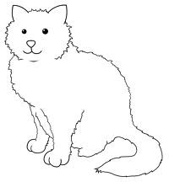
WILD TYPE SUBSTITUTION INSERTION (SINGLE) INSERTION (MULTIPLE) DELETION (SINGLE) DELETION (MULTIPLE) INVERSION (SMALL) INVERSION (LARGE)
THE CAT SAT ON THE MAT THE RAT SAT ON THE MAT THE CAT SPAT ON THE MAT THE CATTLE SAT ON THE MAT THE C*T SAT ON THE MAT THE CAT *** ON THE MAT THE TAC SAT ON THE MAT TAM EHT NO TAS TAC EHT

Slide 7
When DNA molecule replicates, any changes
due to mutations of the original DNA
base sequence will be duplicated and passed on to the next generation. Mutations are inherited.
DNA is used as a template in transcription to make RNA. Mutation in the DNA sequence will be passed on to the mRNA. mRNA is translated to give protein. An altered RNA sequence may be translated into altered protein. This may cause defects in vital reactions catalysed by the protein.

Slide 8
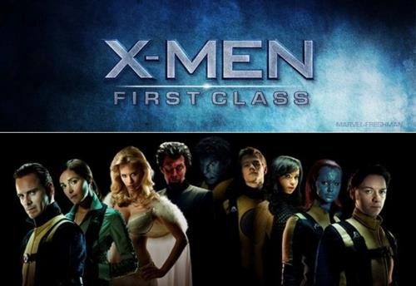
7.2 Different Types of Mutations

Slide 9
(1) Silent Mutation
A mutation in the DNA sequence that has no effect on the operation of the cell.
Silent mutations do not alter the phenotype.

Slide 10





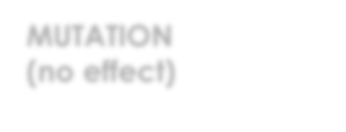






Categories of Silent Mutation
1. When the base change occurs in the non-coding DNA between genes. Therefore no genes
are damaged and no proteins are altered.
Gene
X
Gene
DNA
MUTATION
(no effect)
mRNA
Proteins

Slide 11
2. When the change occurs in the introns within many of the eukaryotic genes. Intron is cut out and discarded when the mRNA is made, so an alteration in its sequence will not affect the final protein.

Slide 12


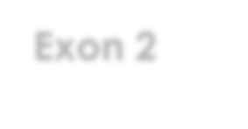

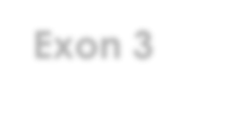



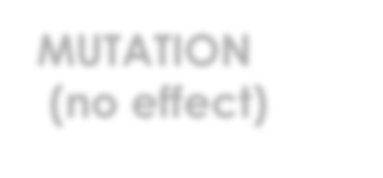



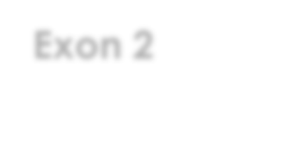
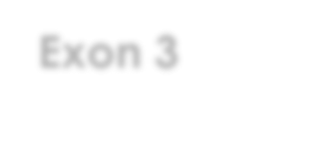





Non-coding region
DNA
Exon 1
Exon 2
X
Exon 3
MUTATION
(no effect)
SPLICING
mRNA
Exon 1
Exon 2
Exon 3
TRANSLATION
Protein (no change)
Polypeptide from Exon 1
Polypeptide
from Exon 2
Polypeptide from Exon 3

Slide 13
2nd base (middle)
1st base | U | C | A | G | 3rd base
U | UUU Phe UUC Phe UUA Leu UUG Leu | UCU Ser UCC Ser UCA Ser UCG Ser | UAU Tyr UAC Tyr UAA STOP UAG STOP | UGU Cys UGC Cys UGA STOP UGG Trp | U C A G
C | CUU Leu CUC Leu CUA Leu CUG Leu | CCU Pro CCC Pro CCA Pro CCG Pro | CAU His CAC His CAA Gln CAG Gln | CGU Arg CGC Arg CGA Arg CGG Arg | U C A G
A | AUU Ile AUC Ile AUA Ile AUG MET | ACU Thr ACC Thr ACA Thr ACG Thr | AAU Asn AAC Asn AAA Lys AAG Lys | AGU Ser AGC Ser AGA Arg AGG Arg | U C A G
G | GUU Val GUC Val GUA Val GUG Val | GCU Ala GCC Ala GCA Ala GCG Ala | GAU Asp GAC Asp GAA Glu GAG Glu | GGU Gly GGC Gly GGA Gly GGG Gly | U C A G

Slide 14
(2) Missense Mutation
When the change in the base sequence alters a codon, so one amino acid in a protein is replaced with a different amino acid.
1. A moderately bad mutation:
GCA -> GGA
Ala -> Gly

Slide 15
Gly and Ala are both relatively small and
uncharged amino acids.
Replacing Ala with Gly in a protein will probably not radically alter its structure.
The critical regions of most proteins occupy only a small proportion of the total protein sequence.
Most changes from one amino acid to another amino acid with similar chemical properties will be relatively mild and usually non-lethal - conservative substitutions.

Slide 16

CONSERVATIVE SUBSTITUTION
GLY
ALA
GCA ⇒GGA
Ala ⇒ Gly

Slide 17
If the exchange is made in a critical region of the protein, such as its active site, its activity might be destroyed completely.

Slide 18
GCA -> GAA
Ala -> Glu
2. A pretty bad mutation:
E.g. Glu is acidic and carries a strong negative charge.
It is most definitely NOT similar to Ala - radical replacement.
This replacement could seriously cripple or even totally incapacitate the protein.

Slide 19

RADICAL REPLACEMENT
Negatively
charged
ALA
GCA⇒GAA ALA⇒GLU
GLU

Slide 20
Temperature sensitive mutation – a type of missense mutation:
- a protein that folds properly at low temperatures
but at high temperatures is unstable and unfolds.

Slide 21
(3) Nonsense Mutation
UCG -> UAG Ser -> STOP
E.g. UCG for Ser. Change from C to A.
We now have UAG which is one of the three STOP
codons.
The ribosome while making the protein comes to STOP mutant codon that used to be Ser. So the ribosome just stops!!
The rest of the protein does not get made.

Slide 22






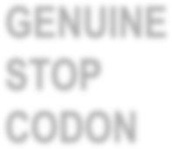


Nonsense Mutation
GENE
X
STOP
CODON
GENUINE STOP CODON
Shortened
protein
DEGRADATION

Slide 23

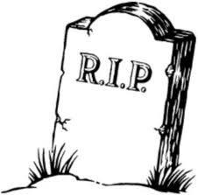
Also called a a chain termination mutation.
Nonsense mutations are often lethal.

Slide 24
(4) Deletions and Insertions
Mutations in which bases are removed are known
as deletions.

Slide 25
Large deletions may move part of a gene, an entire or several genes.
You might think that the more bases we remove, the worse the mutation. Not necessarily!
Consider this piece of RNA message and its translation into protein:
RNA Code: GAG-GCC-GUA-AUC-GAA-UGU -UUG-GCA-AGG -AAA
Protein: Glu - Ala - Val - lle - Glu - Cys - Leu - Ala - Arg - Lys

Slide 26

First, just one base.
We'll delete the middle base of the third codon. And here is what happens:
Wild Type: GAG-GCC-GUA- AUC-GAA-UGU-UUG-GCA-AGG-AAA
Mutant: GAG-GCC-G . A - AUC-GAA-UGU-UUG-GCA-AGG-AAA

Slide 27

By removing a single base we have changed
the reading frame. The RNA will now be translated as:
Wild Type RNA CODE
Protein
: GAG-GCC-GUA- AUC-GAA-UGU-UUG-GCA-AGG-AAA
: Glu - Ala - Val - Ile - Glu - Cys - Leu- Ala - Arg - Lys…..
Mutant
RNA CODE
Protein
: GAG-GCC-GAA- UCG-AAU- GUU-UGG-CAA-GGA….
: Glu - Ala - Glu - Leu - Asn - Val - Trp - Gln - Gly……
With just a single base deletion, our protein sequence has been completely disrupted.

Slide 28
Insertion of a single extra base would have the same effect.
Whenever a mutation changes the reading frame, it is known as frameshift mutation and the resulting protein sequence is total nonsense!
Deletion or insertion of two bases would also change the reading frame, by two spaces in this case, and it would give a similarly disrupted protein.

Slide 29
Wild Type
RNA : GAG-GCC-GUA-AUC-GAA-UGU-UUG-GCA-AGG-AAA
Protein : Glu - Ala - Val - Ile - Glu - Cys - Leu- Ala- Arg- Lys Mutant
RNA : GAG-… GUA – AUC – GAA - UGU – UUG - GCA ….
Protein : Glu - … Val - Ile - Glu - Cys – Leu –Ala …..

Slide 30

Three bases is a complete codon, so when we translate this sequence to make the protein, we delete one amino acid.
Although we have deleted an amino acid, we did
not get out of step during translation; we have reserved the correct reading frame.

Slide 31
In Frame Deletion Mutations
Active site
Active site (unaltered)
Amino acid whose codon will be deleted
Amino acid missing in non-essential loop
Original Protein
Mutated Protein

Slide 32



Similarly, a three base insertion would add a single amino acid, without affecting the rest of the sequence.
It might be OK to add or delete more than three bases as long as the number is a multiple of three.

Slide 33












Large Deletion Mutation
Original DNA
GENE
GENE
Deletion of this area
Mutant DNA
GENE
mRNA
No mRNA
Protein
No protein

Slide 34
(5) Rearranging DNA: Inversions and Translocations
An inversion is where there is an inverted segment of the DNA.

Slide 35






















Original
DNA
INVERSION
Mutant
DNA
Most of Gene 1
Gene 2 (backwards)
Rest of Gene 1

Slide 36
A translocation is when a section of DNA is removed from its original position and moved to another location, either on the same chromosome, or on a completely different chromosome.
If an intact gene is merely moved from one place to another, it may still work and little damage result.
But if, say, half of a gene is moved and stuck somewhere else in the middle of another gene, the result is chaotic and harmful.

Slide 37



























Translocation mutation
Chromosome A
Chromosome B
TRANSLOCATION
Front of gene 3
Back of gene 3
Mutant DNA Chromosome B
Part of gene 2

Slide 38
7.3 What Causes Mutation?

Slide 39
Induced mutations
May be caused by agents that damage the DNA- mutagens. Chemical mutagens (toxic chemicals) and physical mutagen (radiation).
Spontaneous mutations
Even if there are no dangerous chemicals or radiation around, mutations will occur, though less frequently - due to errors in DNA replication.

Slide 40

Chemical mutagens (toxic chemicals)
Toxic chemicals react with DNA and alter the
chemical structure of the bases.
E.g., EMS (ethyl methane sulfonate) adds a methyl group to bases in DNA and so changes their shape.
Nitrite is a chemical that replaces amino groups with hydroxyl groups and so converts the base cytosine to uracil.

Slide 41
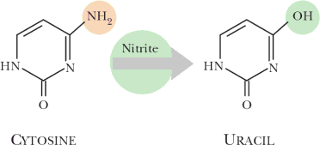

Nitrite Converts Cytosine To Uracil
During DNA replication, the DNA polymerase is confused by the altered bases and puts in wrong bases in the new strand of DNA it is making.
Notes:
NH2 – amino group, OH – hydroxyl group

Slide 42
Bromouracil
Bromouracil mimics the bases found in natural DNA - resembles thymine in shape.
It is converted by the cell to the DNA precursor, bromouridine triphosphate and DNA polymerase will then insert this by mistake where thymine should have gone. Mimics acting like this are called base analogs.
Bromouracil can change between two alternative shapes.

Slide 43
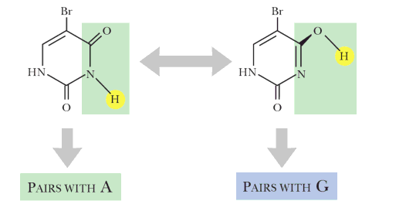

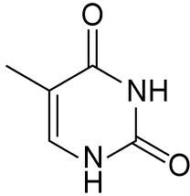
Bromouracil Induces Mutations
Looks like T
(keto form)
Looks like C (enol form)

Slide 44
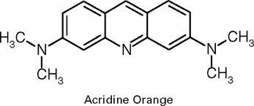
Acridine orange
A more subtle form of chemical mimicry consists of imitating the structure of a base pair rather than a single base.
Acridine orange has three rings and is about the
size and shape of a base pair.
It is not actually incorporated into the DNA.
It squeezes in between the base pairs in DNA that already exists - intercalation.

Slide 45

Acridine Orange is an Intercalating Agent
Acridine orange snuggles between base pairs
Base
pairs

Slide 46
When it is time for DNA replication, the DNA polymerase thinks the intercalating agent is a base pair and it puts an extra base when making a new strand.
Insertion of an extra base will change the reading frame of the protein coded by a gene.
This will completely destroy the function of the protein.

Slide 47
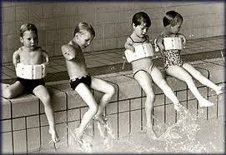
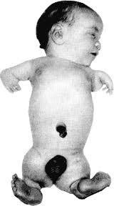
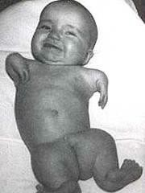
Teratogen
Is an agent that causes abnormal development of the embryo leading to "monstrosities," - gross structural defects (teras means monster in Greek).
E.g. thalidomide which resulted in the birth of malformed children often missing arms or legs, etc. Teratogens are mutagens which have spectacular effects on animals.

Slide 48
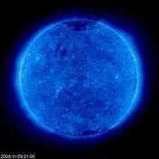
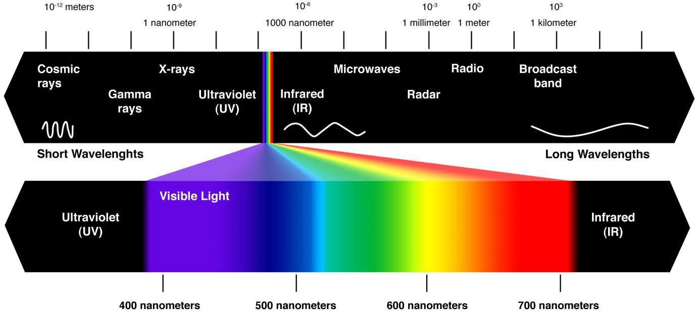
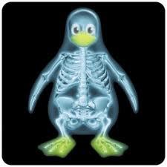
Physical mutagens
Some forms of radiation cause mutations.
High frequency electromagnetic radiation - ultraviolet radiation (UV light), X-rays and gamma rays (γ-rays) - directly damage DNA.

Slide 49


UV Light and Thymine Dimers
G A T T A C G
C T A A A G C
UV LIGHT
G A A C G
C T A A A G C
UV radiation makes two neighboring thymine bases react with each other to give thymine dimers - confuse DNA polymerase which will make mistakes when synthesizing a new strand of DNA.

Slide 50
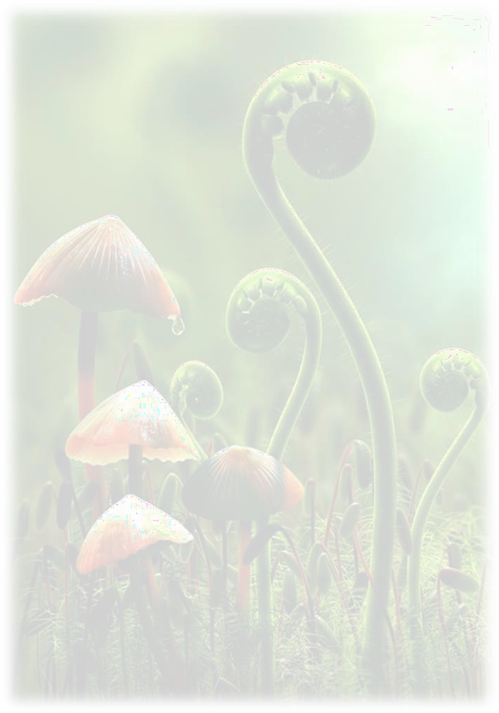
UV radiation is emitted by the sun. Most is absorbed by the ozone layer in upper atmosphere - does not reach the surface of the earth.
If the ozone layer is destroyed by the chlorinated hydrocarbons used in aerosol sprays and refrigerants, the amount of UV reaching the earth increase drastically.

Slide 51
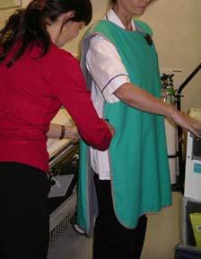
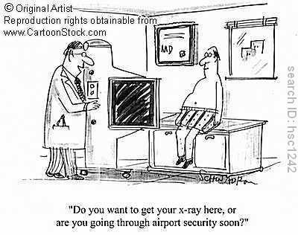
X-rays
Used in the early days to generate mutation in the laboratory, to produce multiple mutations and often yield arrangements of the DNA (e.g. deletions, inversions, translocations).

Slide 52
There are other forms of radiation such as α−particles and β - particles emitted by radioactive materials along with y-rays.
There are also cosmic rays which, some from outer space. Most α-particles are too weak to penetrate skin and it is the β - particles which you need to worry about.

Slide 53
7.6 Reversion and Suppression
Suppose we have a mutant and its DNA gets mutated again.
There is a small chance that the second mutation
will reverse the effect of the first- reversion.
Reversion refers to the observable outward characteristics of our organism (a phenotypic term).
The likelihood that exactly the one base out of
millions that was previously mutated, will be the very one to mutate again is extremely low.
Those rarities where the original base sequence is
exactly restored are true revertants.

Slide 54
More often our revertants actually contain a second base change that cancels out the effect of the first one. These are second-site revertants.
Examples: The simplest to understand is if the original mutation was a frameshift mutation due to deletion or insertion of a single base. This alters the reading frame and disrupt the protein sequence.

Slide 55

Wild Type
DNA : GAG - GCC - ATC - GAA - TGT- TTG -GCA - AGG-AAA
Protein : Glu – Ala – Ile – Glu – Cys – Leu – Ala – Arg - Lys
Original Deletion Mutant
DNA : GAG -G.C - ATC -GAA - TGT- TTG- GCA - GTG - TTG - GCA -AGG
Grouped as : GAG – GCA – TCG – AAT –GTT – TGG…..
Protein : Glu - Ala – Ser - Asn – Val – Trp ……..

Slide 56
But suppose we now insert an extra base a little way further along the sequence. This second site insertion will restore original reading frame.
Revertant
DNA: GAG – G.C – AATC – GAA –TGT – GCA – GTG – TTG – GCA ….
Grouped as : GAG – GCA – ATC – GAA – TGT – GCA …..
Protein : Glu - Ala – Ile- Glu – Cys – Leu ……..

Slide 57
Although the DNA sequence is not identical to its original state, the protein has been exactly restored.
Similarly, an insertion mutation can be corrected by a second-site deletion.
The key to success when reverting is to restore activity to the protein, not to get the exact actual DNA sequence back.

Slide 58
A less obvious but more frequent case is where the original mutation as a base change.
Consider a protein with 100 amino acids
whose correct 3-D structure depends on
the interaction between a positively charged amino acid at position 25 to a negatively charged one at position 50.
Suppose the original mutation changes codon no. 50 from GAA for Glu (negatively charged) to AAA which encodes Lys, a positively charged amino acid. The protein's folding is now disrupted.

Slide 59

Misfolded Mutant Protein
First mutation
+
+
-
+

Slide 60


A true revertant could be made by replacing AAA with GAA. However, suppose instead codon No. 25 is mutated to give a negatively charged amino acid. We now have a negative charge at position No. 25 and a positive charge at No. 50.
We have now restored the reaction between these two regions and the protein will fold O.K. again.
Sometimes, sometimes not - it depends on other factors, such as whether these alterations change the active site.

Slide 61

Misfolded Mutant Protein
First mutation
+
+
-
+
SECOND SITE REVERSION CURES DEFECT
Second site mutation
+
+
-
+

Slide 62
7.7 DNA Repair
Most cells contain a variety of damage control systems and some of these can repair damaged DNA.
A variety of mutations may result in a base pair that doesn't actually pair properly.
This will cause a slight bulge in the DNA double helix that alerts the proteins of the system.
This repair system cuts out the wrong base and fills in the gap with the right base to make a correctly bonded base pair.

Slide 63



G
A C G A T C T A G
T G C _{T}
G
A C G A T C
T G C T A G T
A C G G A T C T G C C T A G
MISMATCH REPAIR SYSTEM

Slide 64
Conclusion
Mutations are of vital importance to us all for
two main reasons:
First, if a mutation occurs in the reproductive cells and can be inherited, it may have major effects on the lives of those who receive it.
Second, mutations that are not inherited but arise
after birth in cells of the body, may cause cancer.

Slide 65
End of Chapter 7!
Thank you

